Slide 1

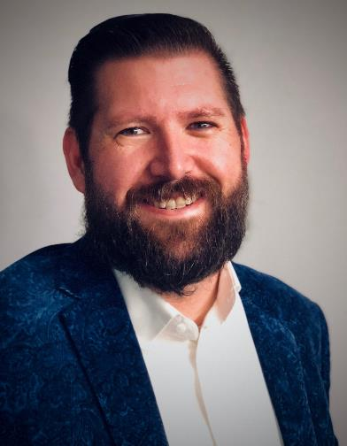













Matt Schneider
+1 678.570.6786 (call or txt)
resume@mdschneider.me
Strategist | Architect | Evangelist |Leader
^{/in/mdschneider}
Matt draws on 20+ years of progressive experience and responsibilities; across technical domains, industries and leadership roles. He excels breaking down complex issues, building a wholistic strategy and team to accelerate success.
Highlights
Work Experience
See Following Page for Details & Links
Visit LinkedIn for More Details
2021 - Present
Chief Architect (Virtual CTO)
Founding Steering Committee Member of Dell Technologies CTO Ambassador Program. NPS: 90+ w/ 200+ members.
2019 - 2021
Field CTO & Principal Engineer
Coverage: North America – All Segments
Quota: ~32 Billion - 50% of all Dell revenue
Started the Enterprise Architecture Practice in PreSales – Top Dell Initiative
Pathfinders
Next-Gen Workshops w/ NPS: 90+
Internal & External Influence
2018 - 2019
Director, Enterprise Architecture
Coverage: Americas – Select Customers
Quota: ~11 Billion
Top rated speaker at multiple
Dell Technologies World sessions.
2016 - 2018
Field CTO, Enterprise South US
Coverage: Texas Enterprise Customers
Quota: ~250 Million
23 years of progressive & diverse experience
Awarded vExpert Status for blogging & community contributions.
2014 - 2016
VP, Infrastructure & Ops
Scope: Hands on Leadership of 130+ Engineers
Budget: ~40 Million Direct + ~60 Million Oversight
Personal Strengths
2012 - 2014
Sr. Director, Infrastructure
Scope: Hands on Leadership of 80+ Engineers
Budget: ~20 Million Direct + ~35 Million Oversight
Organizational Leadership
Business & IT Alignment
Technical Depth & Breadth
Wide Industry Experience
Hands On Problem Solving
Implementing Change
Tool & Process Development
Motivated Learner & Teacher
Story Telling…….
2006 - 2012
Distinguished Engineer
2001 - 2005
Managing Architect/Director
HealthLogic
1998 - 2001
Developer/Architect/Director

Slide 2
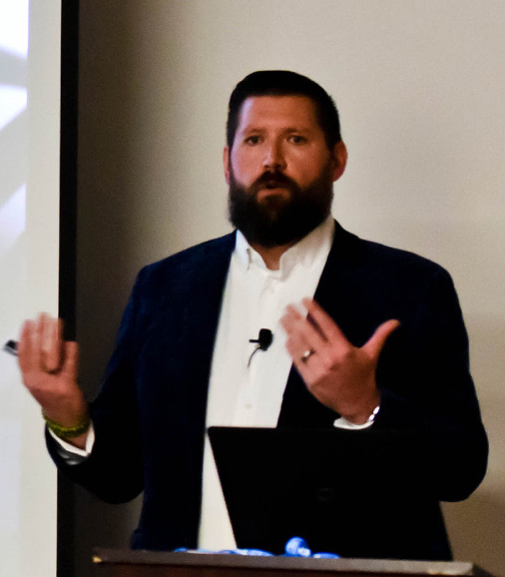


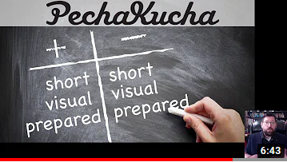




“Stories constitute the single most powerful weapon in a leader’s arsenal” – Dr Howard Gardner, Harvard Professor
I believe how we convey information is quickly becoming one of the most important skills in our industry. It doesn’t matter if it’s a video, a PowerPoint or a whiteboard, we must strive to share our knowledge and provide guidance in a form that not only is well understood, but captivating. Below are some examples of my journey in Story Telling.
My Pecha Kucha on Pecha Kucha
In learning to be more succinct and speak to executives, I lean on the Pecha Kucha model, as well have been championing this approach internally – ask me about Pecha Kucha Roulette.
Cloud Positioning
Over my time at Dell, I have advised hundreds of customers on their Cloud Strategy, sharing my approach and practices internally, including at our 2020 Summit for Global PreSales.
PathFinder Soft Skill Workshops
Leading from the front, I have delivered this workshop to all new-hires 2018-2020, countless account teams, as well at Intern programs and Universities as part of our Diversity out-reach.
Additional artifacts related to roles & projects over the past decade.
Completely custom talk track and associated custom PowerPoint deck.
2020 Customer Bio
2018 Personal Retrospective
2015 Personal Retrospective
2013 Personal Retrospective
Cloud Positioning
Account Warming
Containers for Marketing
DevOps & ITIL
* Content has proprietary information obscured and used with permission for references.
*Decks have all been presented in public, large events and in college courses I’ve taught.
Please find my most recent VisualCV at: https://bit.ly/MattSchneider-VisualCV

